Slide 1
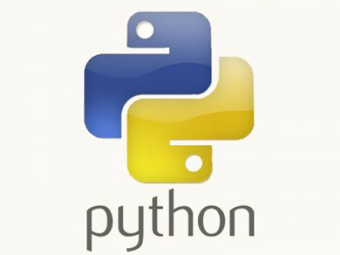
Python Training.....
-- Jeetendra Bhattad

Slide 2
Agenda
Object Oriented Programming Pillars
Methods in Classes
Object attribute v/s Class attribute
Public, Private attributes & functions
Assignments

Slide 3
Object oriented programming pillars
Pillars
  Abstraction
  Encapsulation
  Inheritance
  Polymorphism
What is class ?
What is object ?
  State, behavior & identity

Slide 4
Methods in Classes
Manager
  Constructor : __init__
  Destructor : __del__
Mutator
  Setter Methods
  e.g SetName
Accessor
  Getter Methods
  e.g GetName
Overloaded
  __getslice__
  __getitem__
  __setitem__
  __add__
  __sub__
  __div__
  __mul__
  __repr__ etc,

Slide 5
Private in Python
__ prefixed to variable or function makes it private.
__ at begin & end is for builtin methods.
No protected status

Slide 6
Assignments
Write a simple BankAccount class. Account number should be auto-generated. Implement withdraw and deposit methods for the same. Write a menu driven program to perform account operations.
Write a base class Shape which has constructor, destructor, Draw, Area methods. Create Square, Rectangle & Circle as the derived classes of the same.
Write a menu driven program for maintaining Employee record.

